Slide 1
FG4017 DEVLOG
Development Log
Bruno Mirone BA (Hons) Game Design, Level 4, UCA
Built in Unreal Engine 5.6 using Blueprints only
Notes:
Solo project. Blueprint only, no C++.

Slide 2
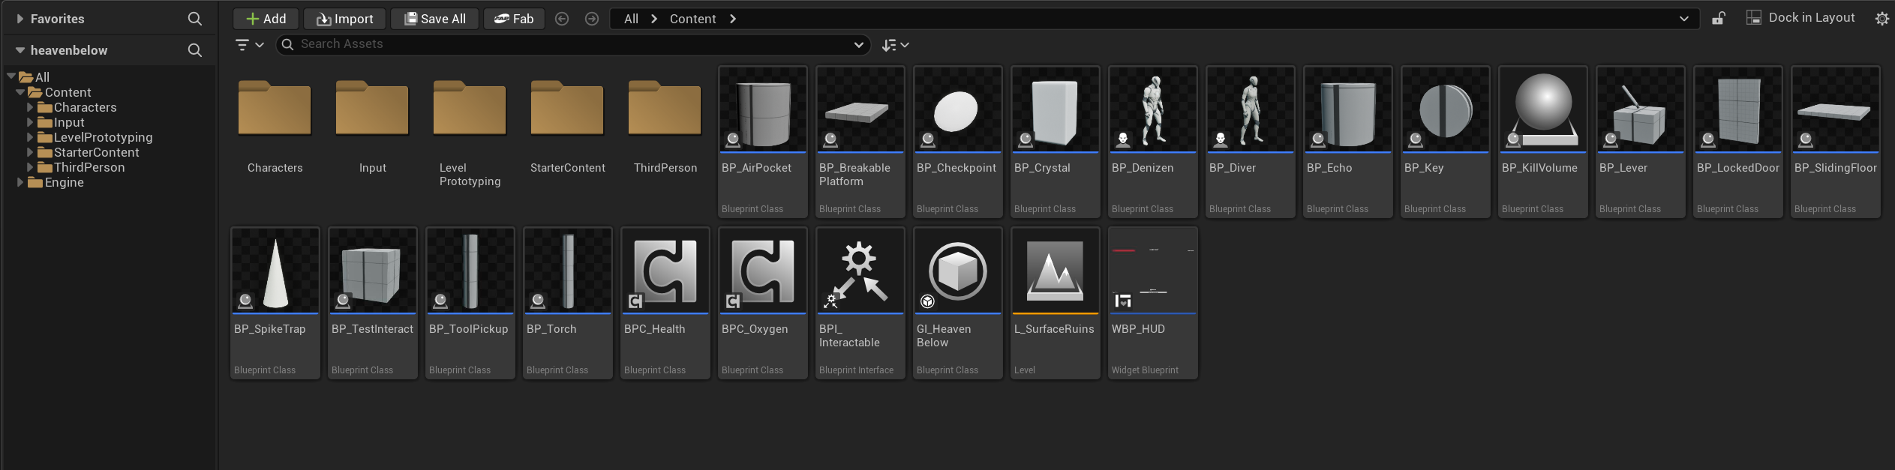
Everything in the project
Twenty two assets in total: sixteen actors, two shared components, one interface, a Game Instance, one widget and one level.
Content Browser

Slide 3
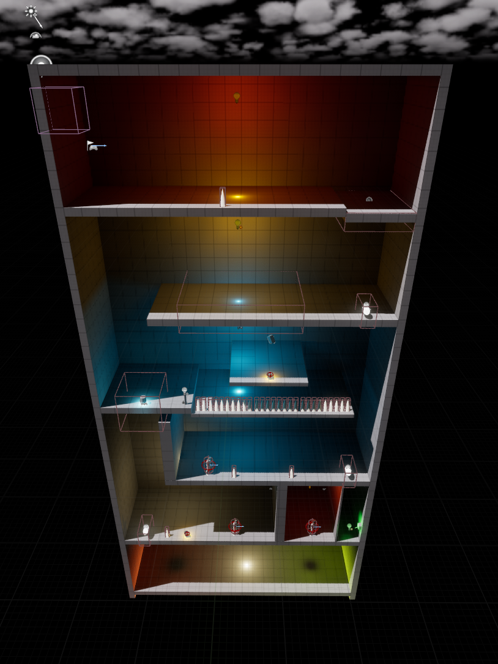
The level
Level 1 is one enclosed vertical shaft with six landings that alternate left and right, so all progress is downward and there is no way back up.
L0
Spike trap, then a breakable platform that drops you in
L1
Checkpoint, air pocket and a sliding floor you must slide across
L2
Torch and crystal reveal the bridge to the first Echo
L3
The Denizen drops the key for the locked door
L4
Spike trap, the second Echo, and a lever that opens the way down
L5
Air pocket, the last Echo and the tool that ends the level
L_SurfaceRuins, seen from outside

Slide 4
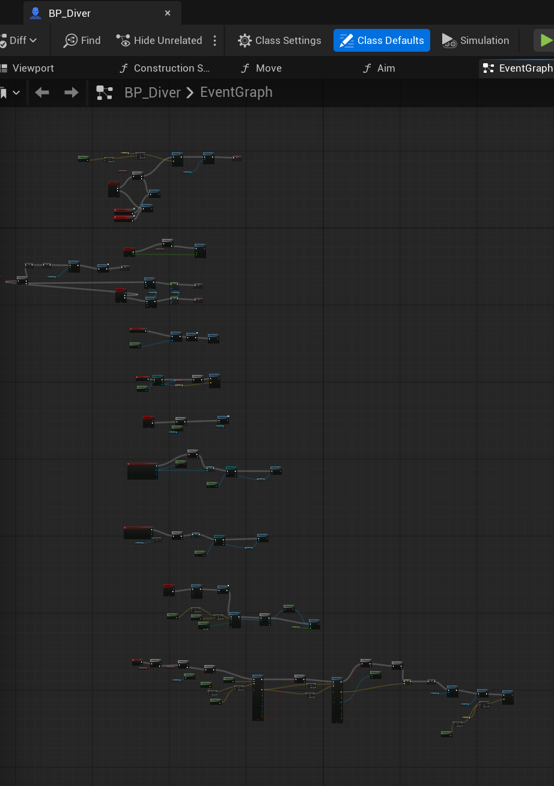
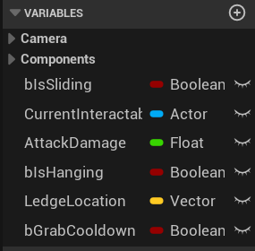
The player
One Blueprint holds every player system, and every value the design needs to tune lives on it as a variable.
BP_Diver, Event Graph
BP_Diver, variables

Slide 5
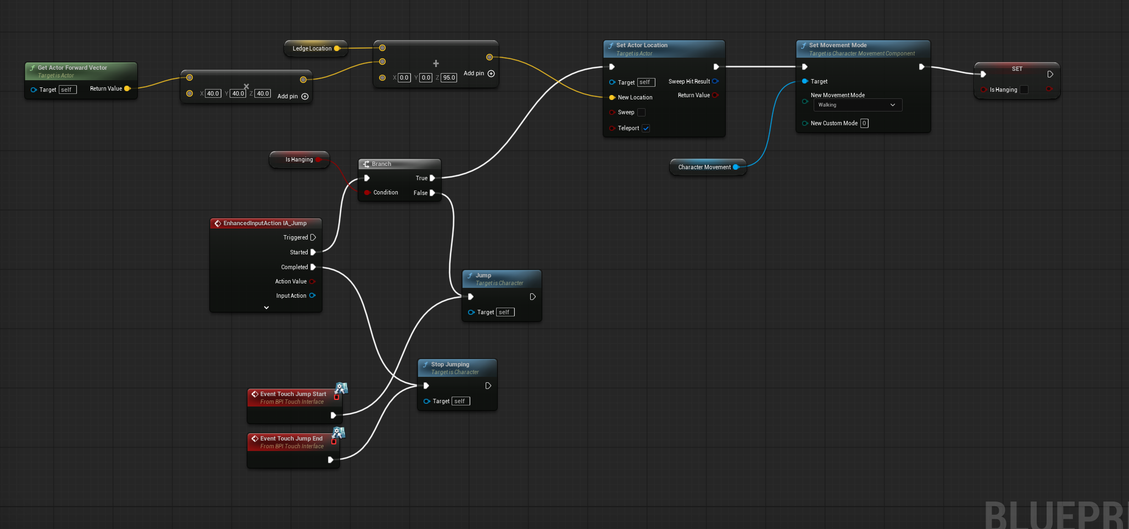
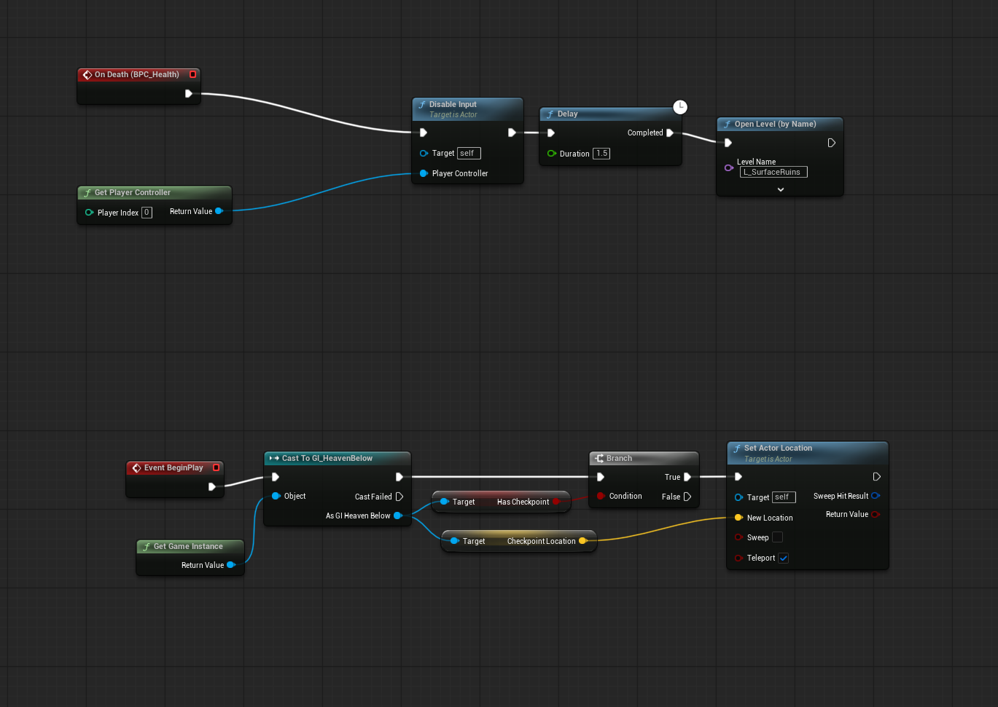
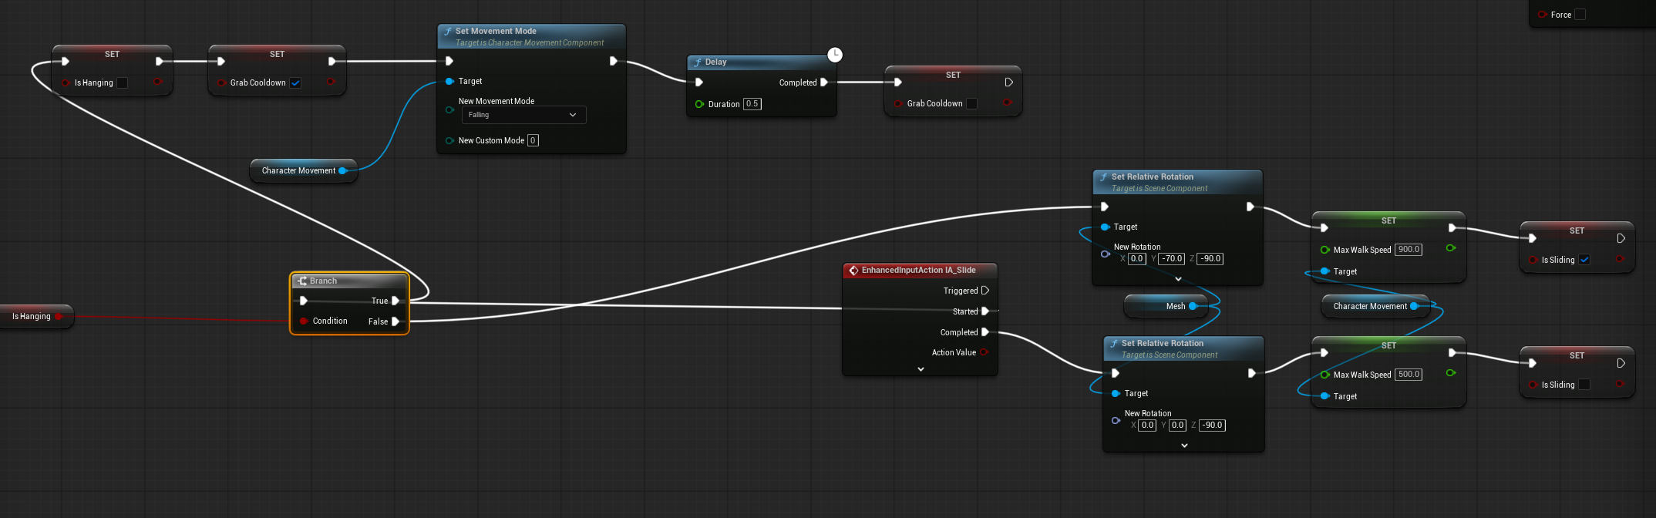
Jumping, sliding and dying
Jump either pulls the Diver up a held ledge or jumps normally, sliding tilts the mesh and raises walk speed, and death disables input then reloads the level at the last checkpoint.
BP_Diver, jump and mantle
BP_Diver, slide
BP_Diver, death and respawn

Slide 6
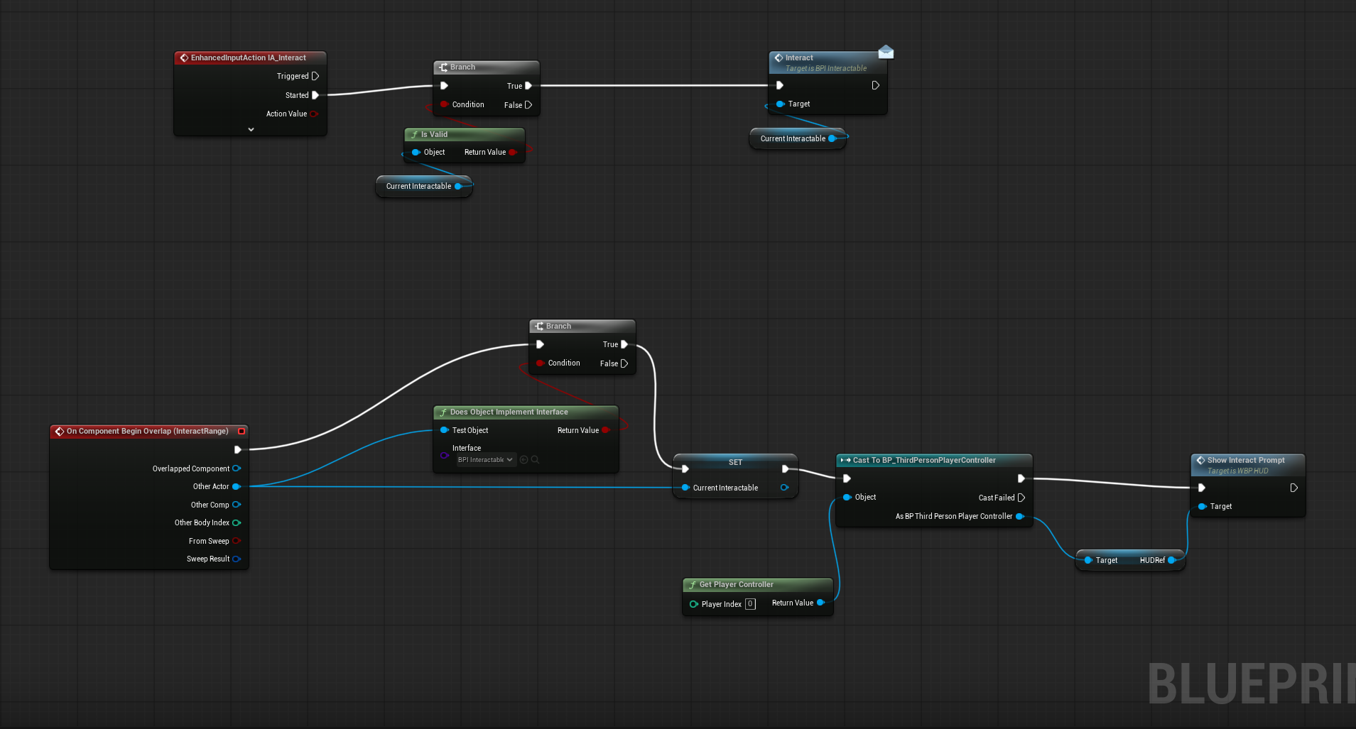
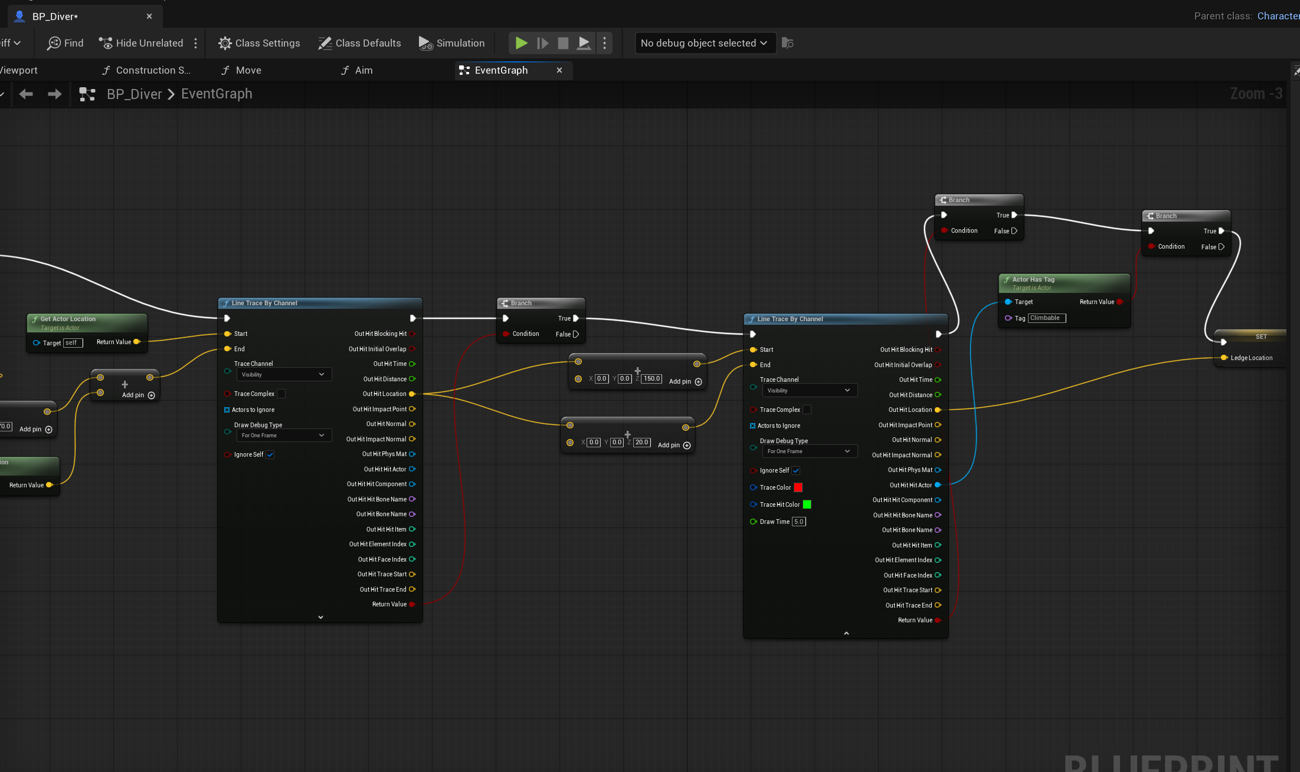
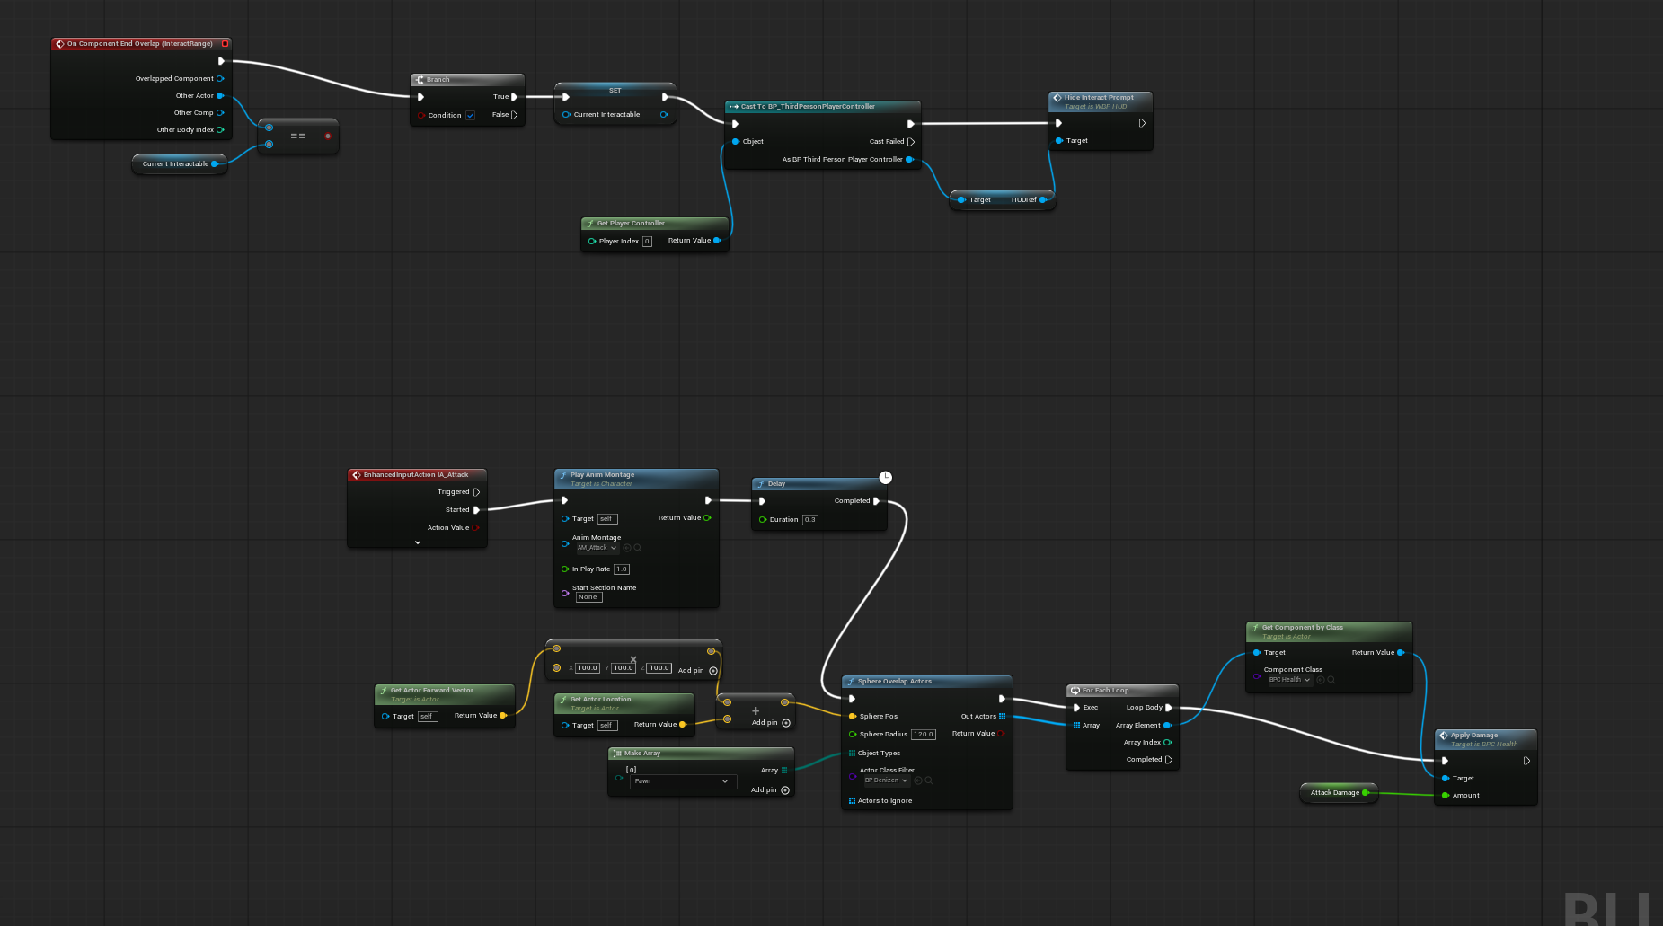
Interacting, attacking and climbing
A sphere on the Diver watches for anything that implements the interact interface, the attack sweeps for Denizens in front of the player, and two line traces look for a ledge to grab while falling.
BP_Diver, interact
BP_Diver, attack
BP_Diver, ledge detection

Slide 7
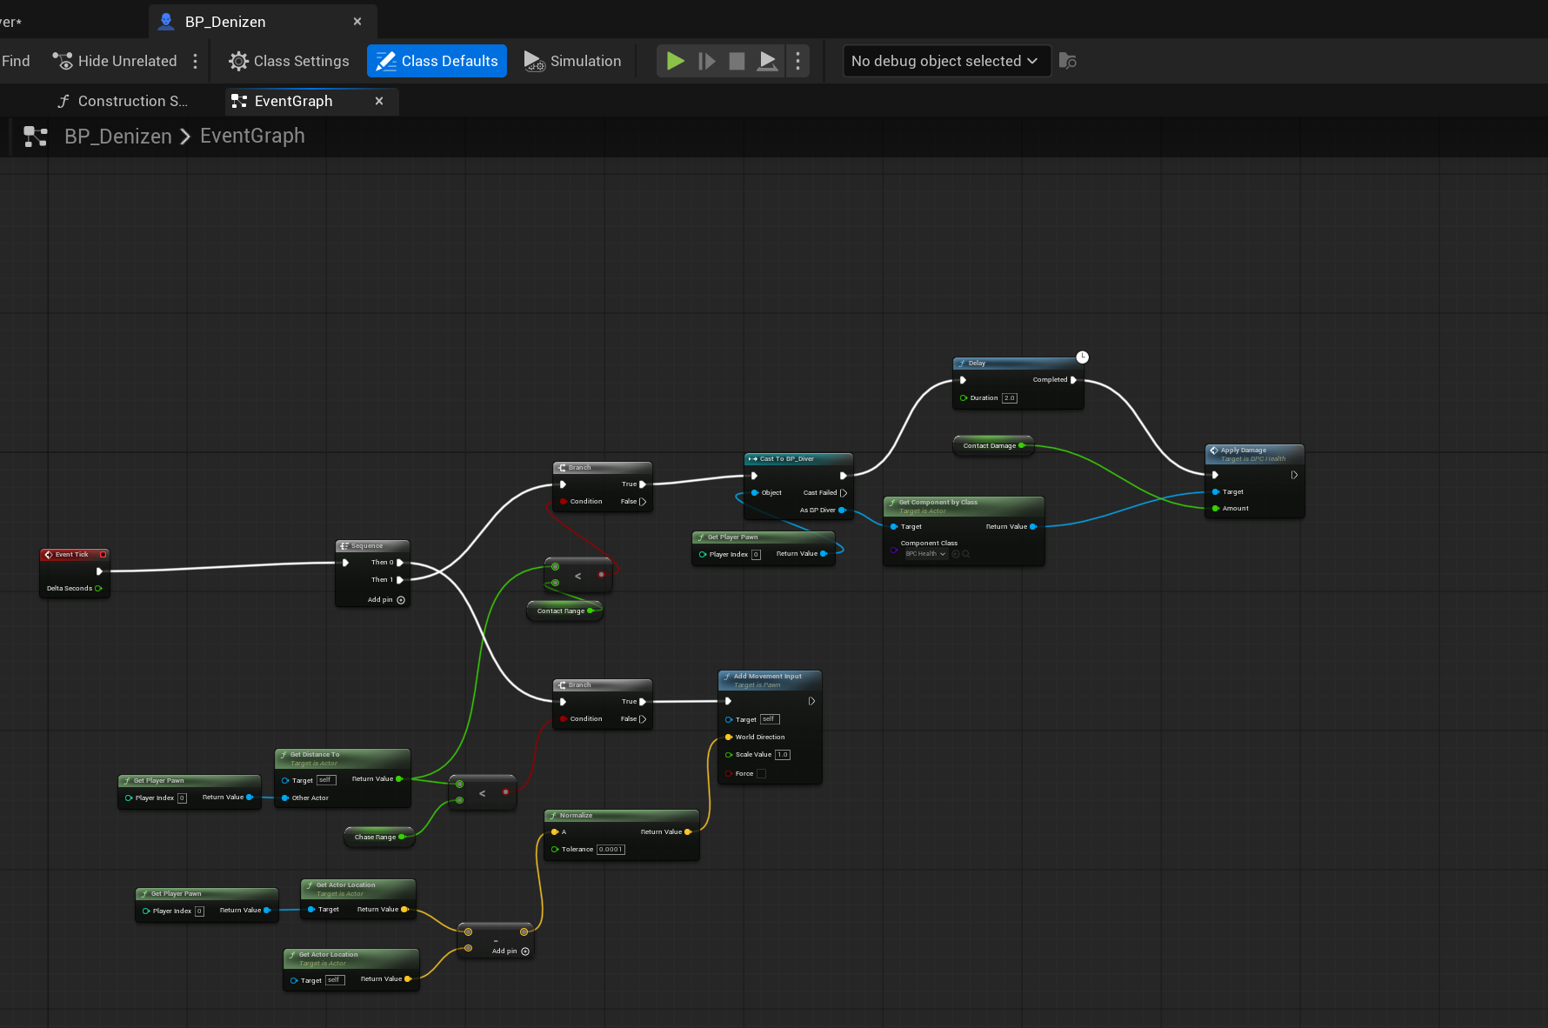
The Denizen
The Denizen measures its distance to the player every frame and either walks toward them or damages them on contact with a two second cooldown.
BP_Denizen, Event Graph

Slide 8
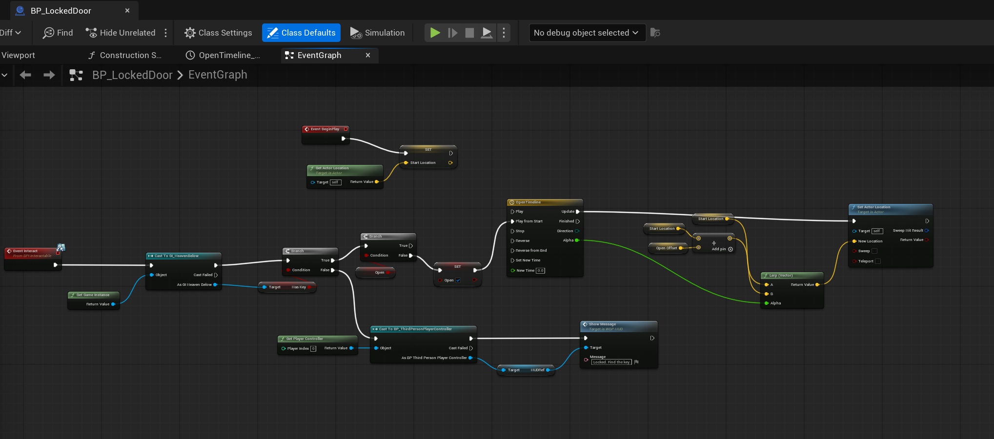
The locked door
The door checks the Game Instance for the key and either opens on a Timeline or tells the player through the HUD that it is still locked.
BP_LockedDoor, Event Graph

Slide 9
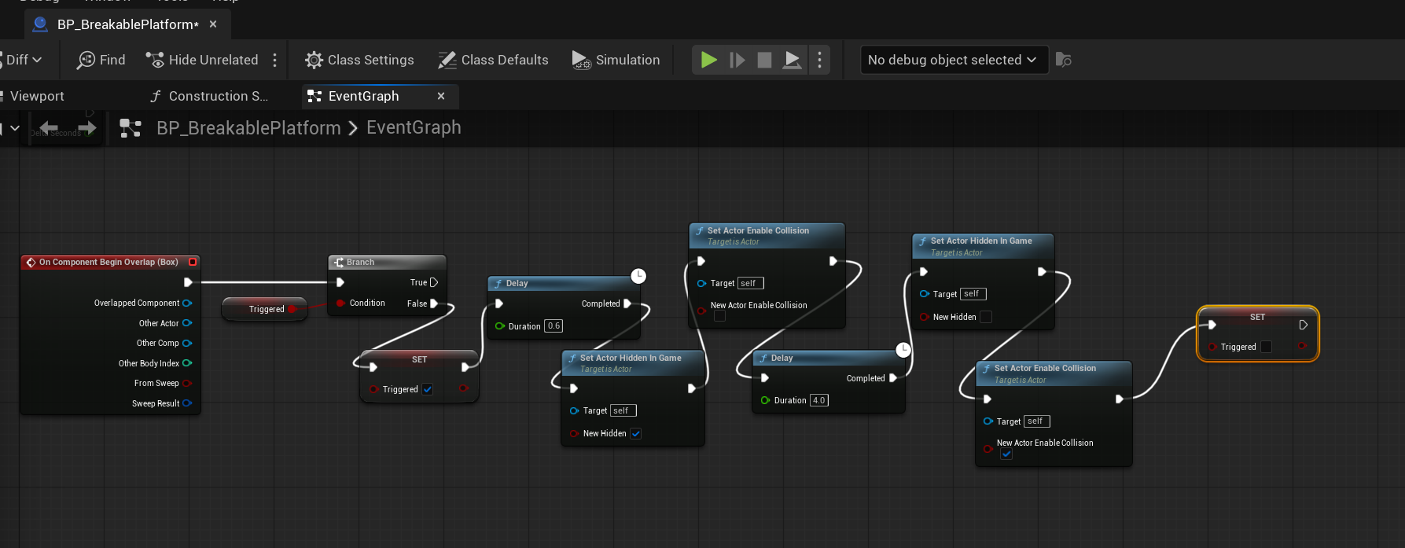
The breakable platform
Standing on it starts a short delay, then it hides itself and drops its collision, and four seconds later it returns so the level can be replayed.
BP_BreakablePlatform, Event Graph

Slide 10
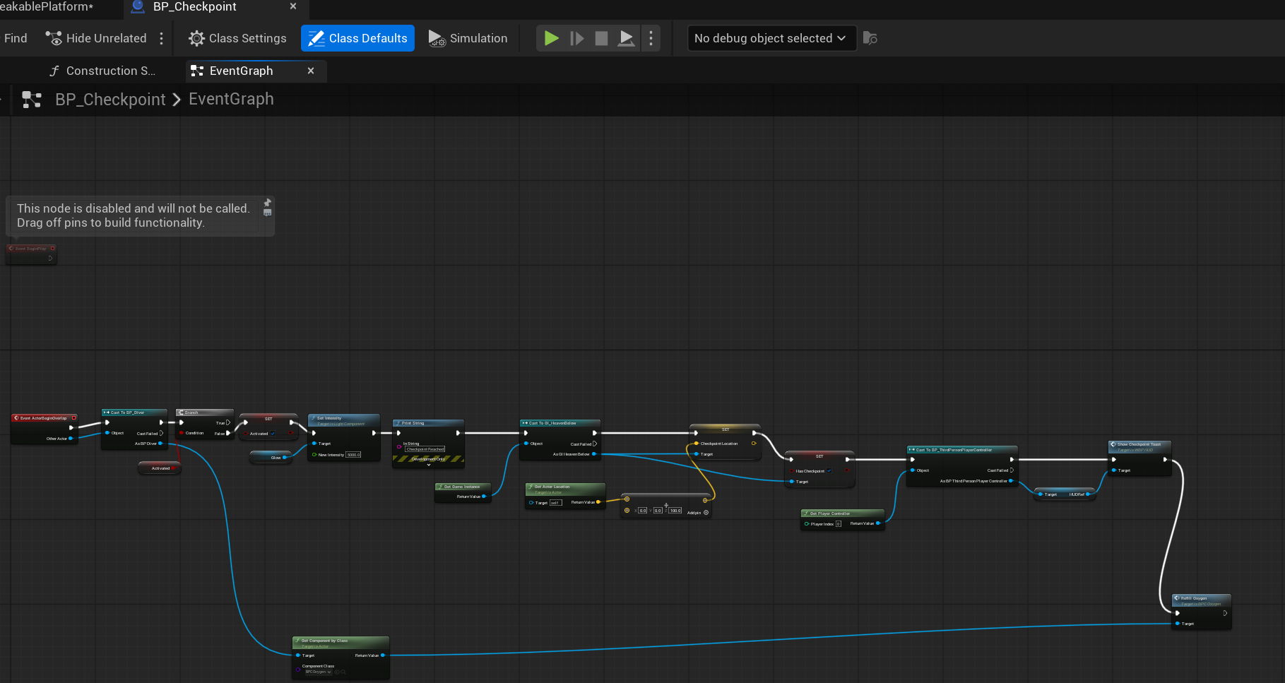
Checkpoints
Touching a checkpoint lights it, stores the location on the Game Instance so it survives a level reload, refills oxygen and shows a toast on the HUD.
BP_Checkpoint, Event Graph

Slide 11
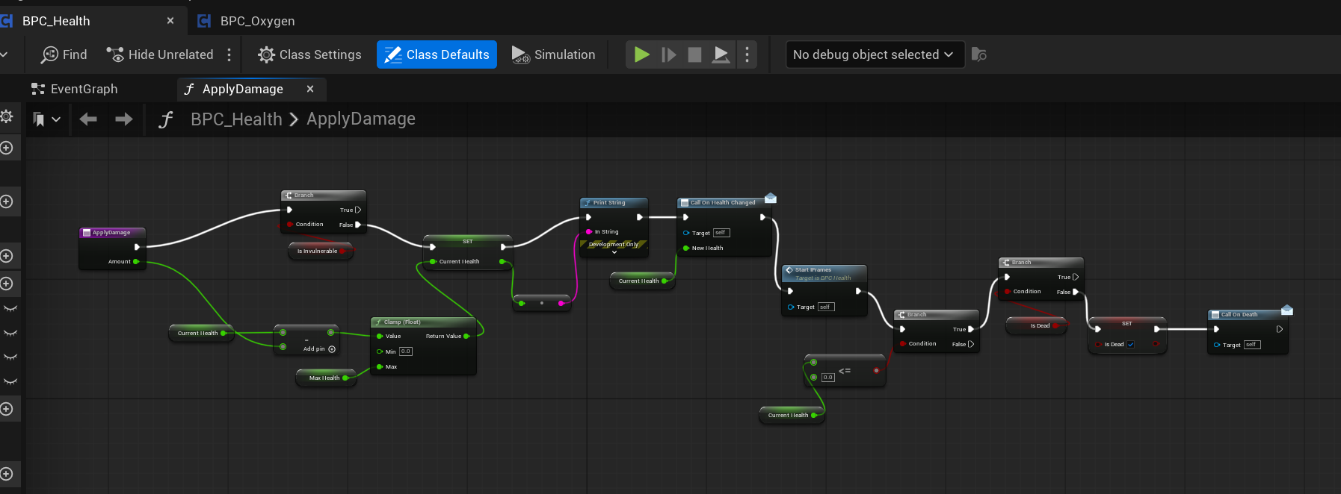
Shared health
One reusable component handles damage for the Diver and the Denizen, clamping health, granting a second of invulnerability and firing death only once.
BPC_Health, ApplyDamage

Slide 12
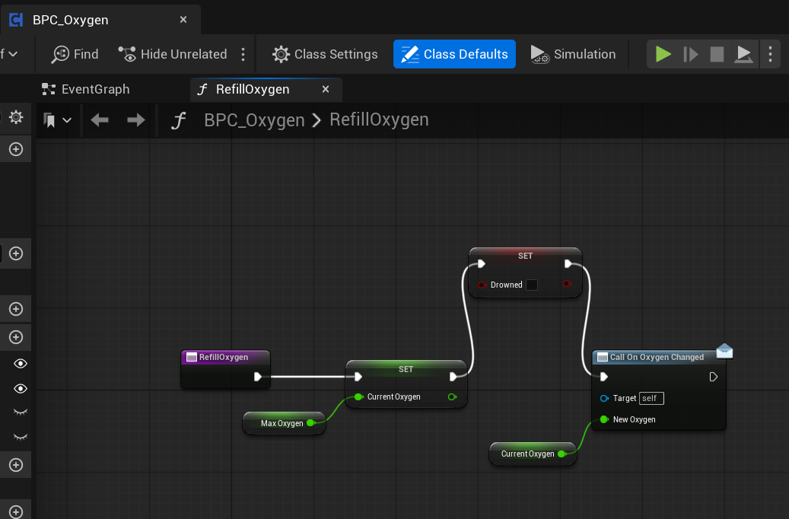
Oxygen
Oxygen drains on a timer and is the real clock on the level, so refilling it resets the value, clears the drowned flag and updates the HUD.
BPC_Oxygen, RefillOxygen

Slide 13
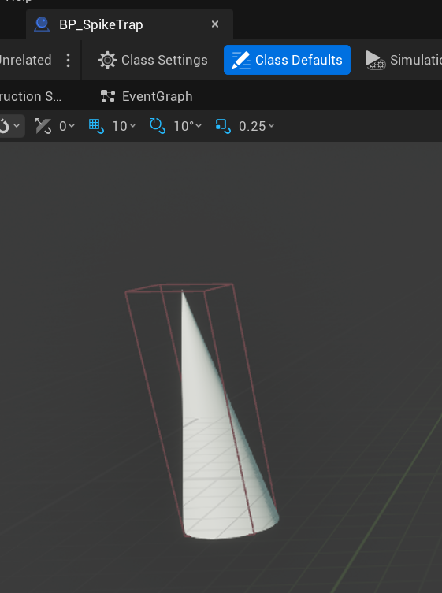
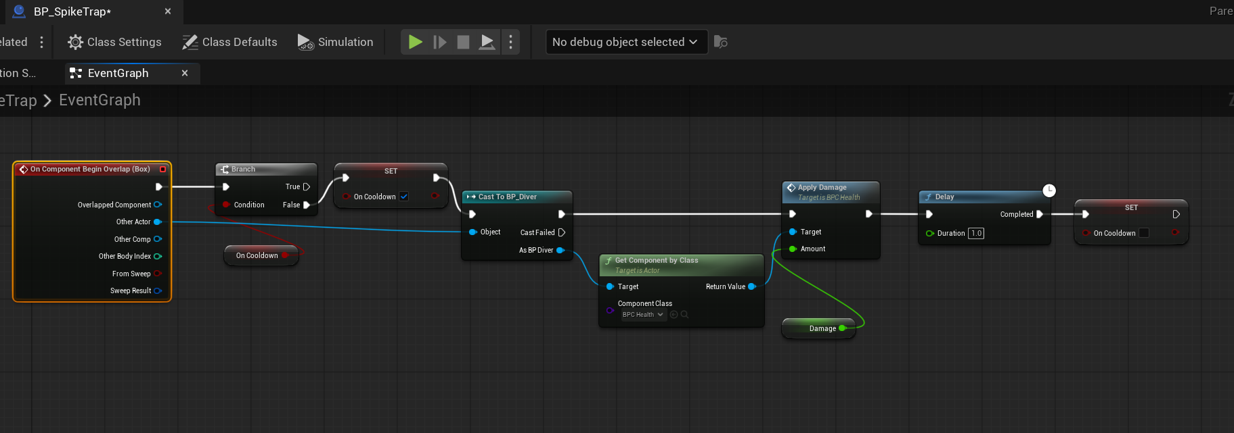
The spike trap
The trigger box is deliberately larger than the spike mesh so the hazard is not missed at running speed, and a one second cooldown stops it draining health every frame.
BP_SpikeTrap, viewport
BP_SpikeTrap, Event Graph

Slide 14
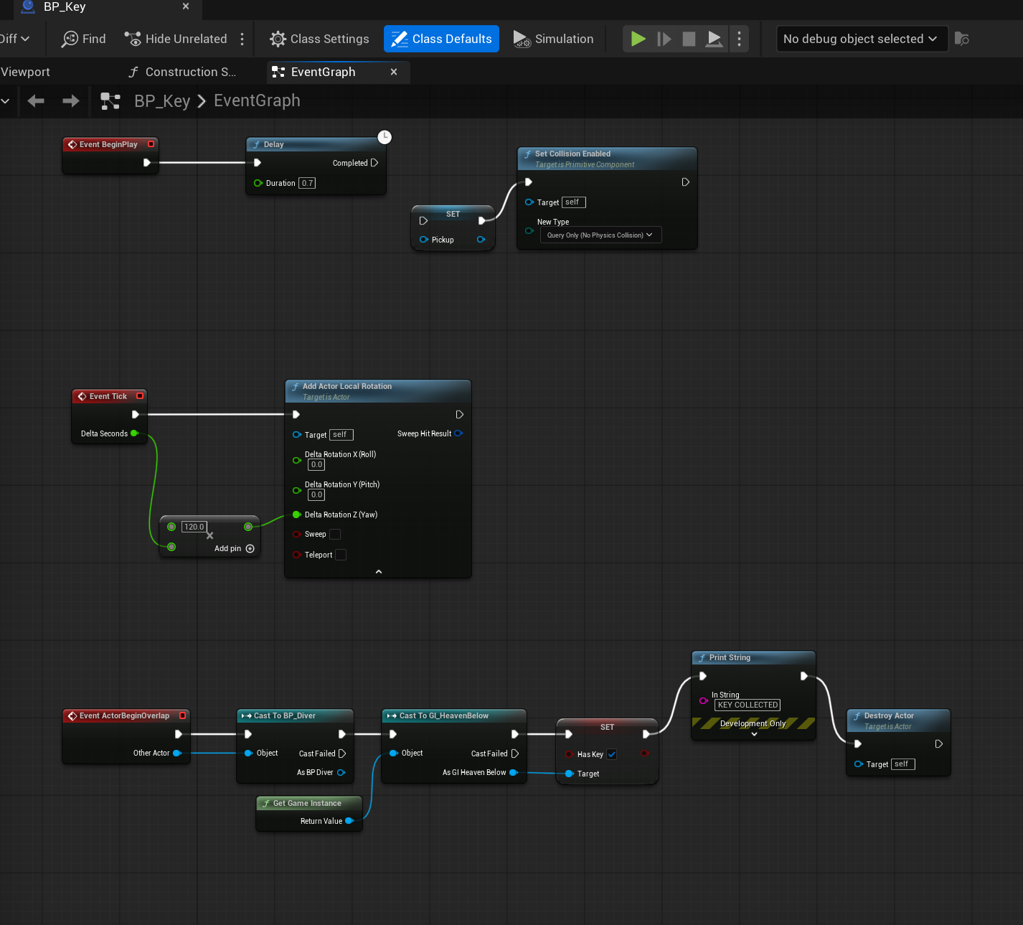
The key
The key spins to draw the eye, arms its pickup collision after a short delay so it cannot be collected inside the Denizen, and records itself on the Game Instance.
BP_Key, Event Graph

Slide 15
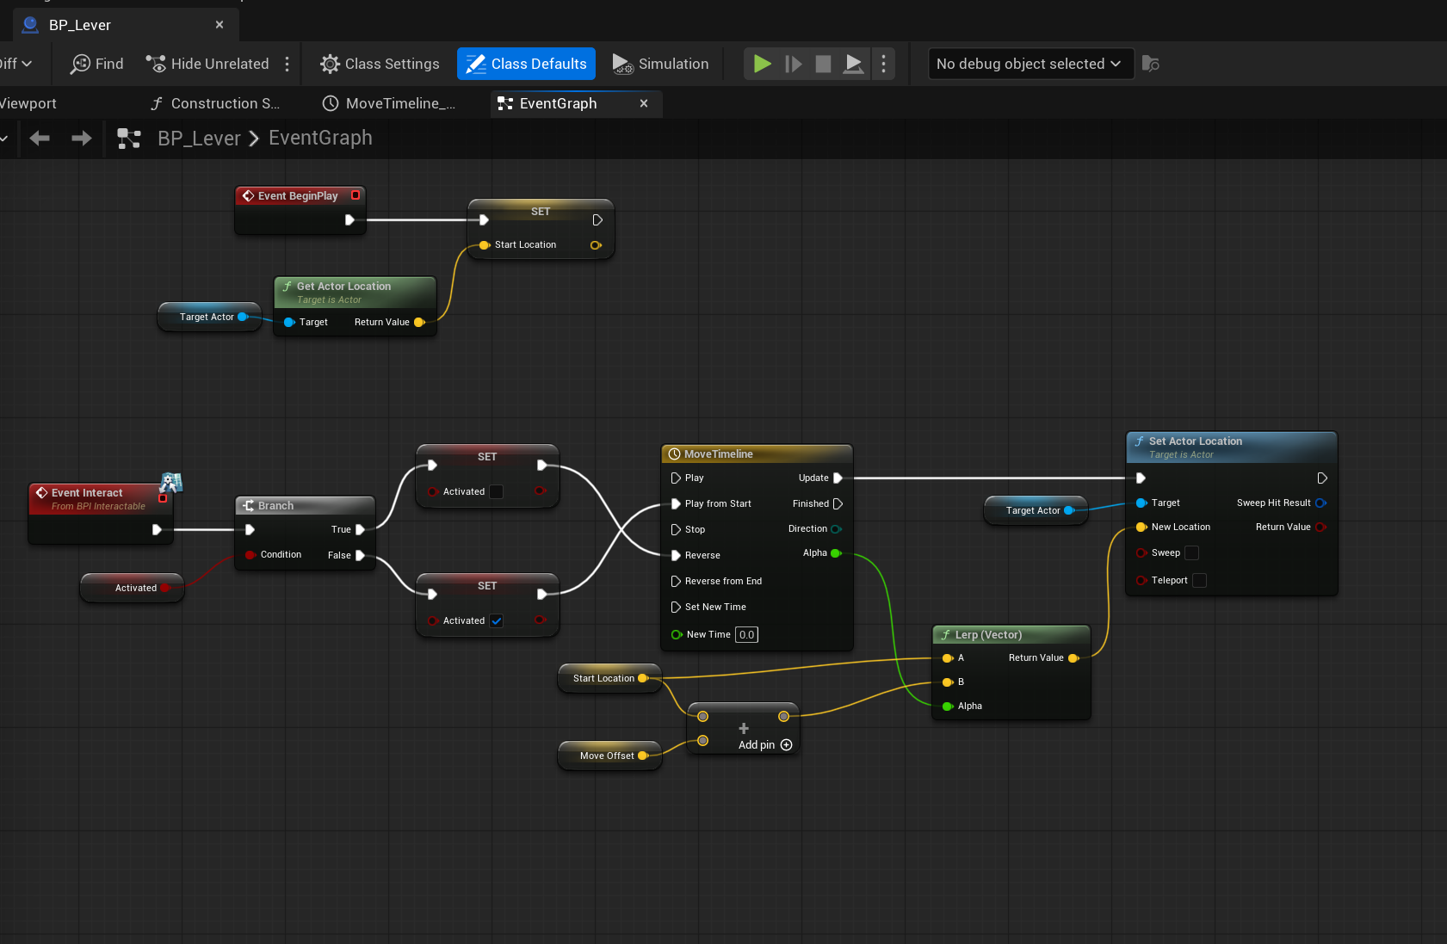
The lever
The lever stores its target's starting position on begin play, then drives a Timeline that moves that actor by an offset set on each copy.
BP_Lever, Event Graph

Slide 16
What I learned
Scope honestly
Components beat copies
The design document describes five biomes and a boss. I built one biome and recorded every cut and the reason for it rather than pretending the rest was still coming.
Writing health once as a component meant the Diver and the Denizen shared it, so adding a second damageable actor cost minutes instead of hours.
Geometry can lie
Read the asset, not the symptom
An engine cube ships with a collision box over three times the size of its mesh. It read as floating above floors and stopping short of walls until I compared the two numbers directly.
Most of my worst bugs produced no error at all. Checking the values actually stored in the asset found in minutes what guessing had not found in hours.

Slide 17
GUNSMOKE MINES
Development Log
Bruno Mirone FGCT4017 Fundamentals of Games Design BA (Hons) Game Design, Level 4, UCA
Built in Unreal Engine 5.6 using Blueprints only

Slide 18
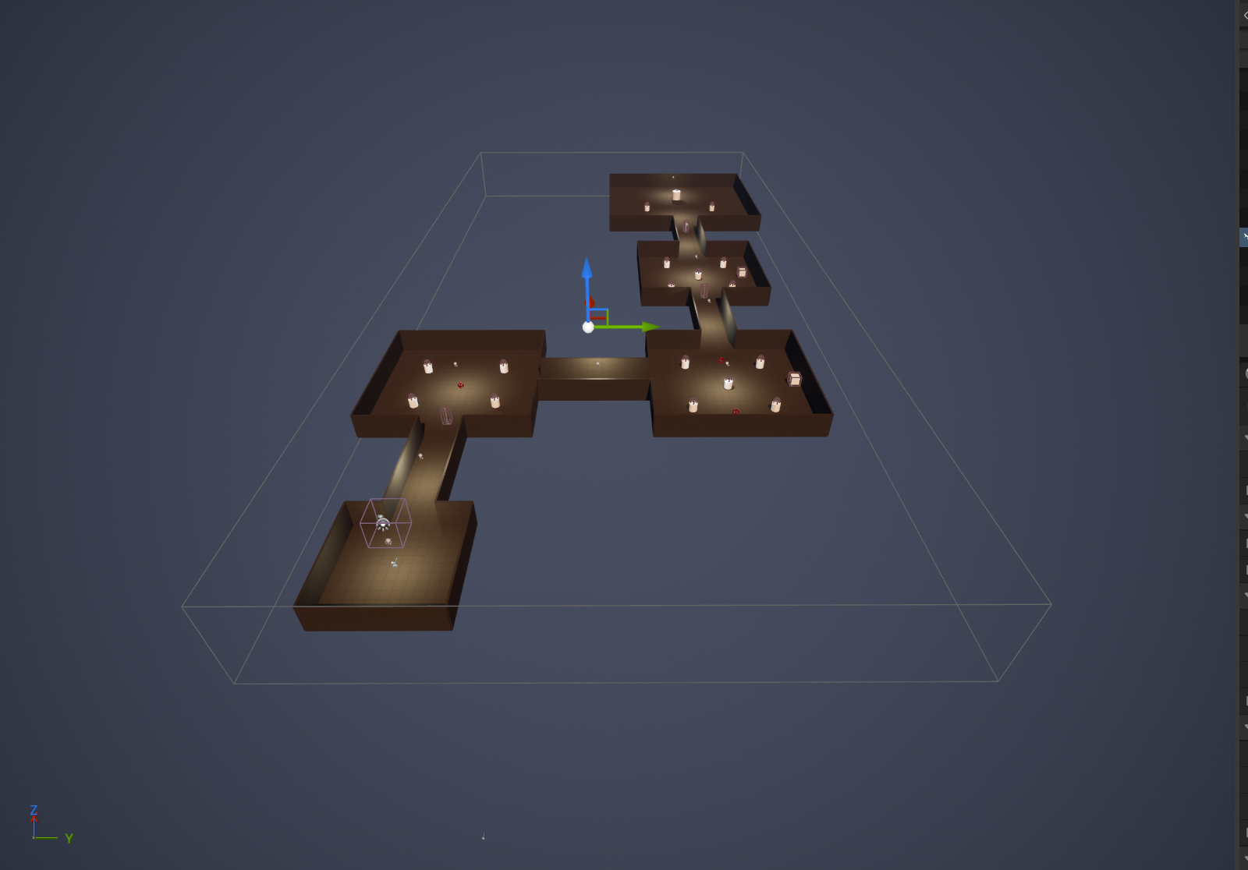
The level
The mine is one continuous level of connected rooms and corridors, blocked out from cubes.
L_Mine, seen from above

Slide 19
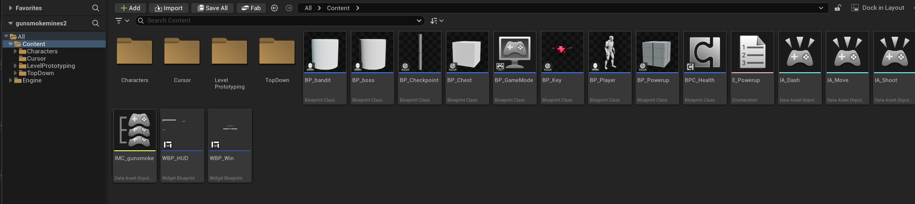
Everything in the project
Seventeen assets in total: eight Blueprints, a shared component, two widgets, the input set and one level.
Content Browser

Slide 20
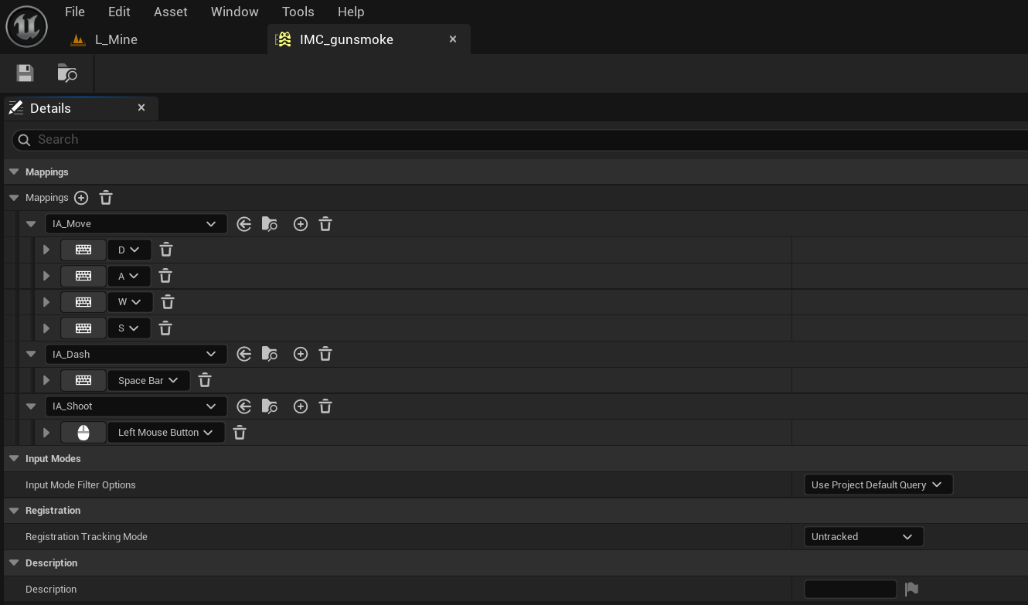
Input
Enhanced Input maps WASD, Space and the left mouse button through a single mapping context.
IMC_gunsmoke

Slide 21
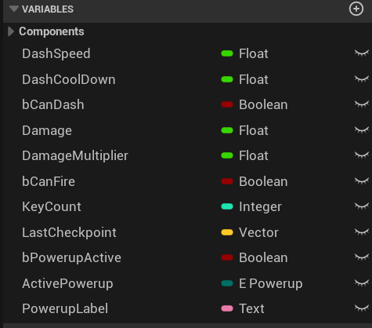
Player variables
Every tunable value lives on the player as a variable, so balancing means editing numbers rather than rewiring.
BP_Player, variables

Slide 22
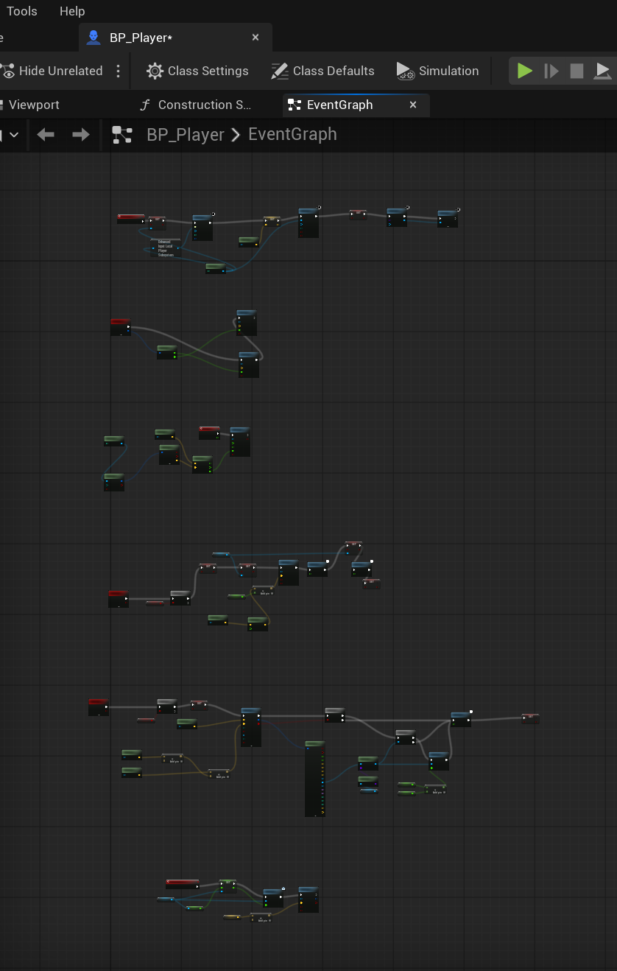
The player
One graph handles movement, mouse aim, the dash, shooting and respawning at the last checkpoint.
BP_Player, Event Graph

Slide 23
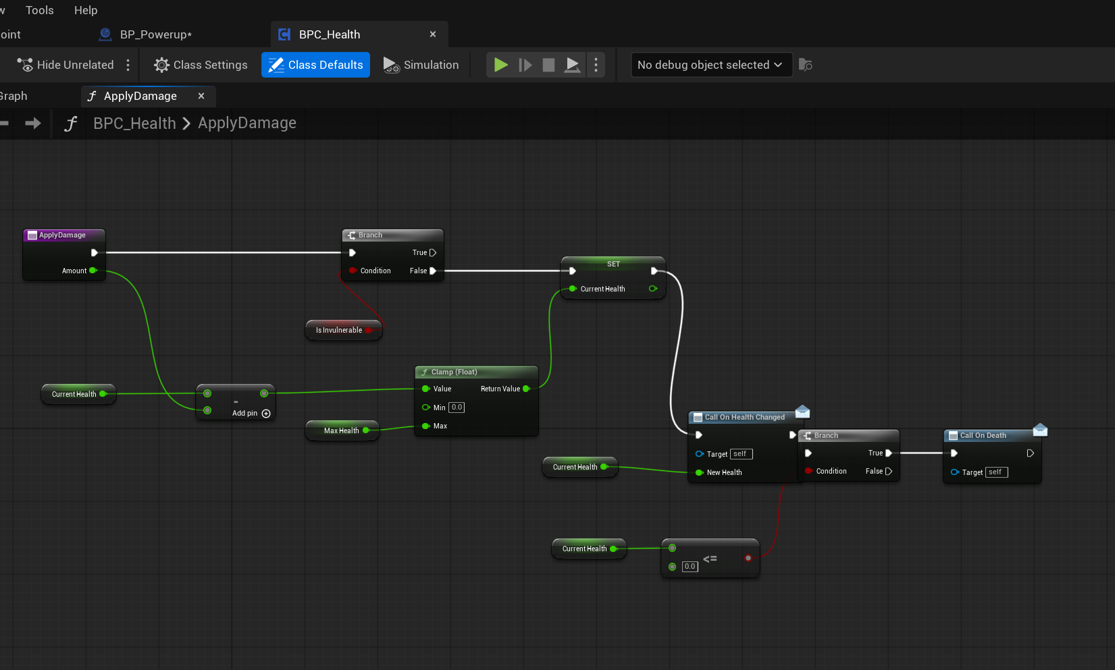
Shared health
A single reusable component handles damage, death and health changes for the player, the bandits and the boss.
BPC_Health, ApplyDamage

Slide 24
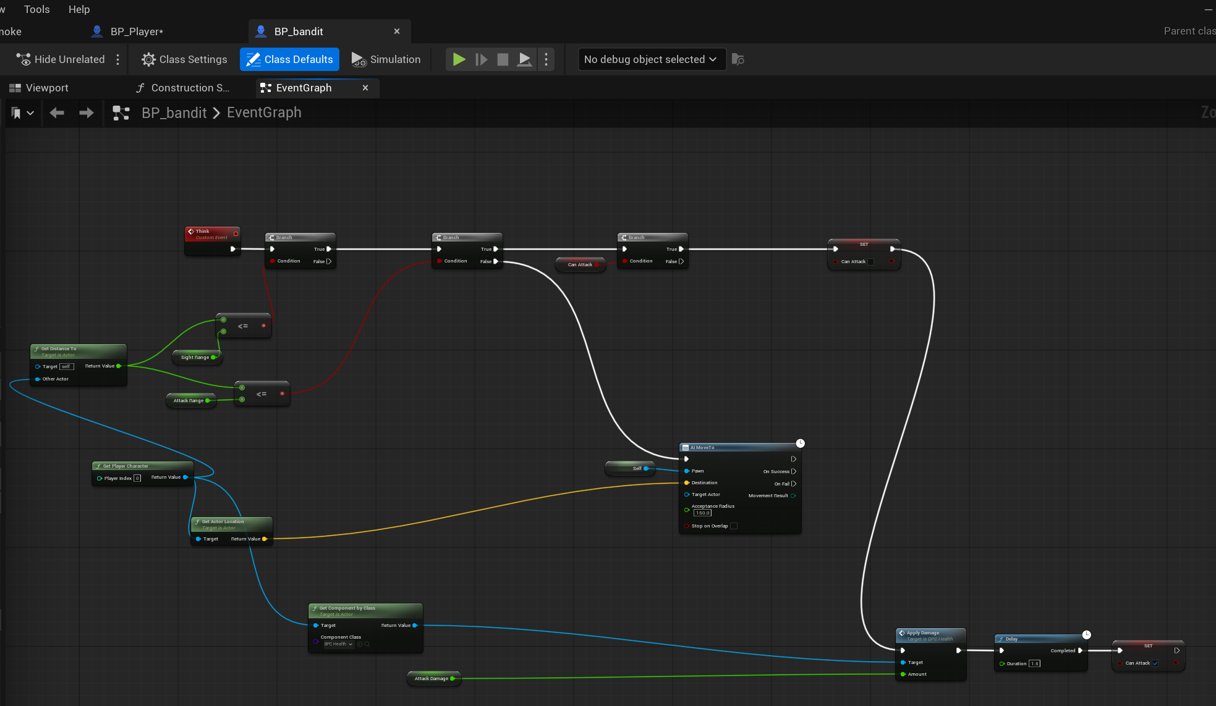
Bandit AI
The bandit measures its distance to the player four times a second and either closes in or attacks.
BP_bandit, Event Graph

Slide 25
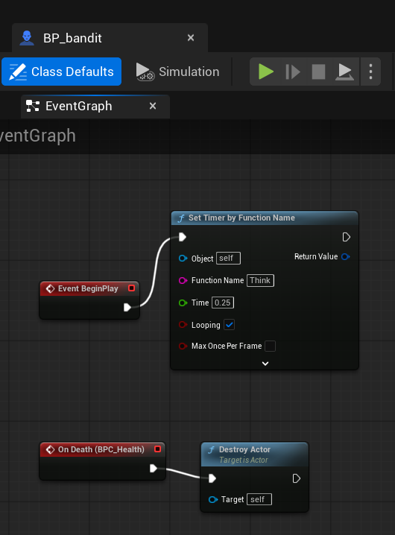
Bandit lifecycle
A looping timer drives the AI, and the health component's death event destroys the actor.
BP_bandit, BeginPlay and death

Slide 26
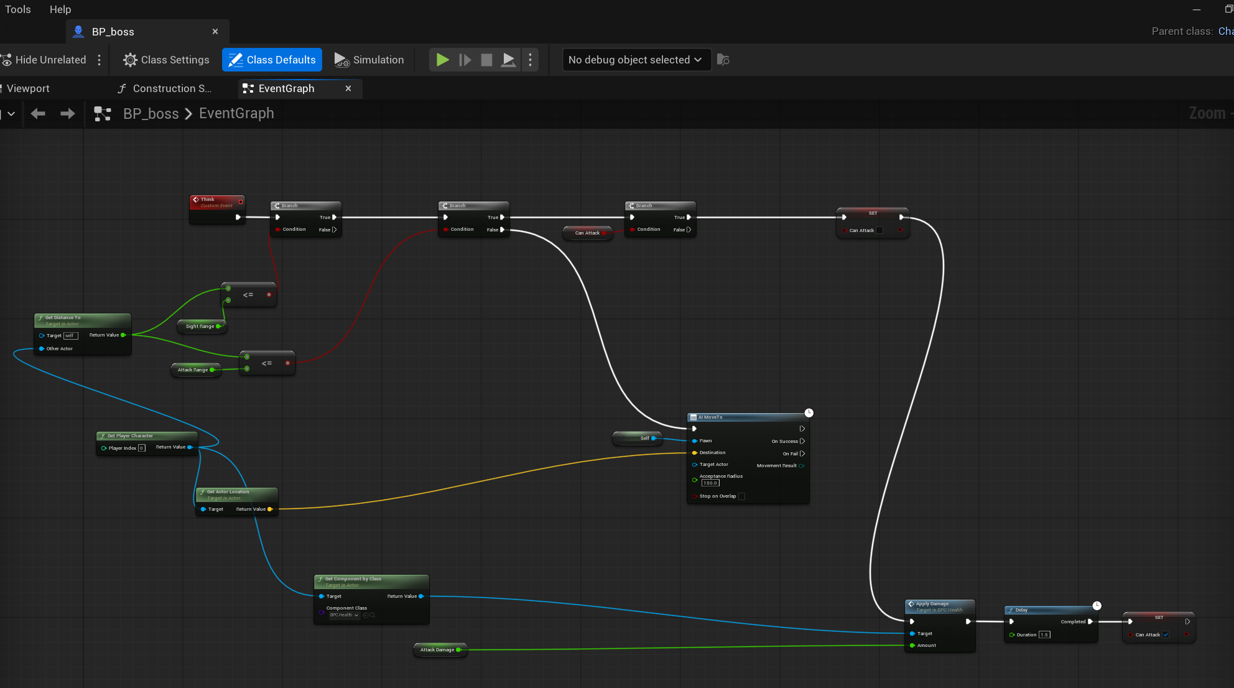
The boss
The boss reuses the bandit's logic with a much larger health pool, slower movement and heavier hits.
BP_boss, Event Graph

Slide 27
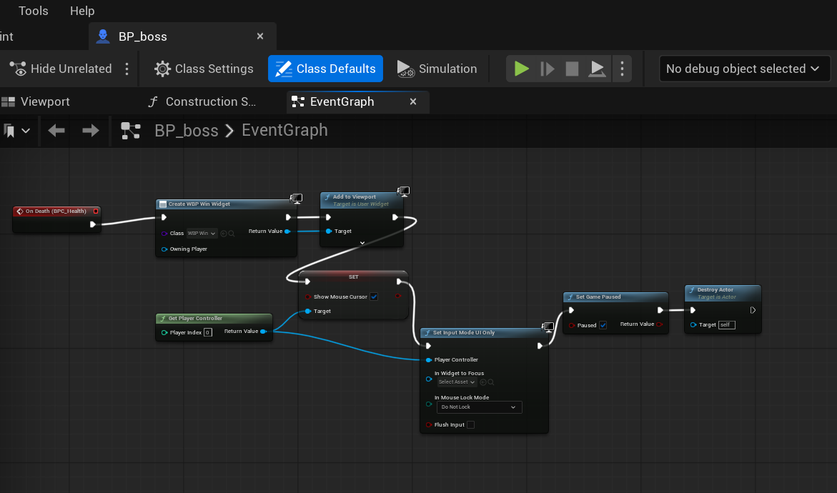
Winning
Killing the boss creates the win widget, pauses the game and hands control back to the mouse.
BP_boss, win condition

Slide 28
Two kinds of powerup
An enumeration keeps the two powerup types readable in the graph instead of using numbers.
E_Powerup

Slide 29
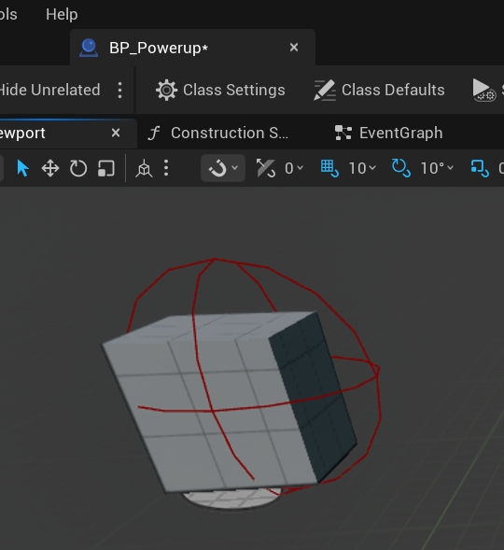
One Blueprint, both powerups
A single actor covers both types, chosen per copy placed in the level.
BP_Powerup, viewport

Slide 30
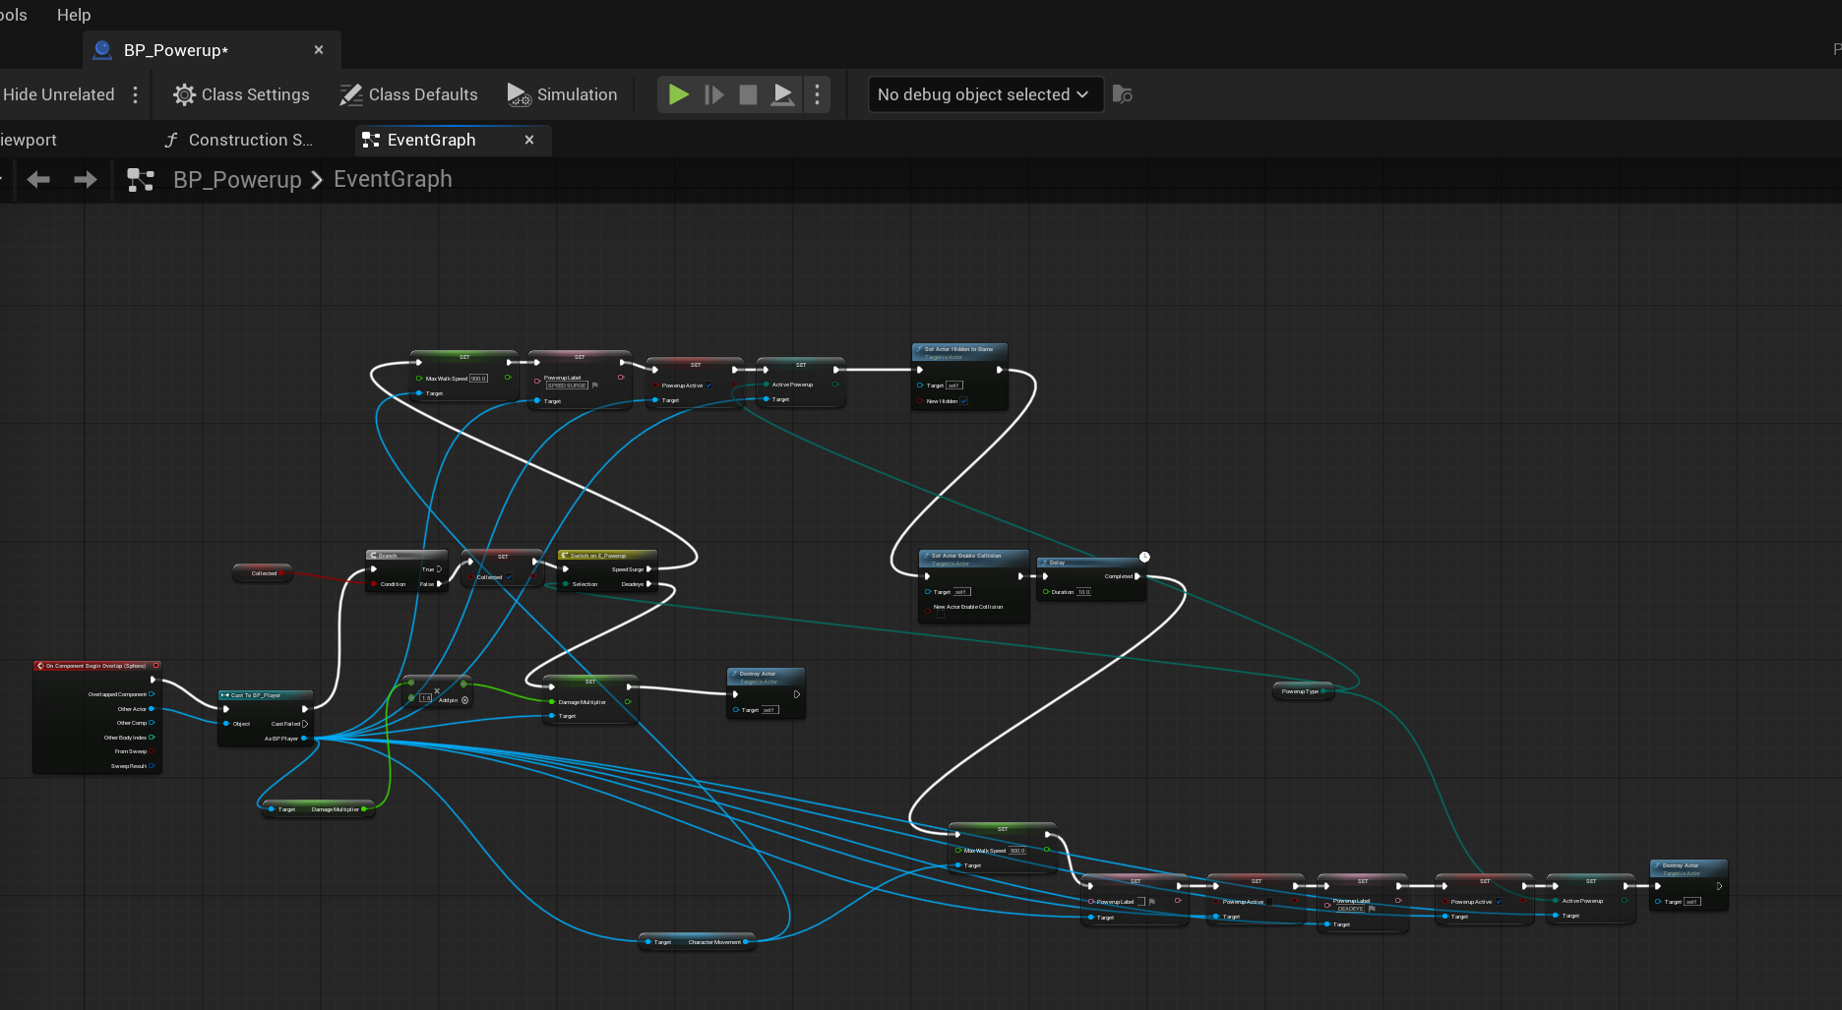
Powerup logic
A switch splits into a timed speed boost that reverts itself, and a permanent damage increase.
BP_Powerup, Event Graph

Slide 31
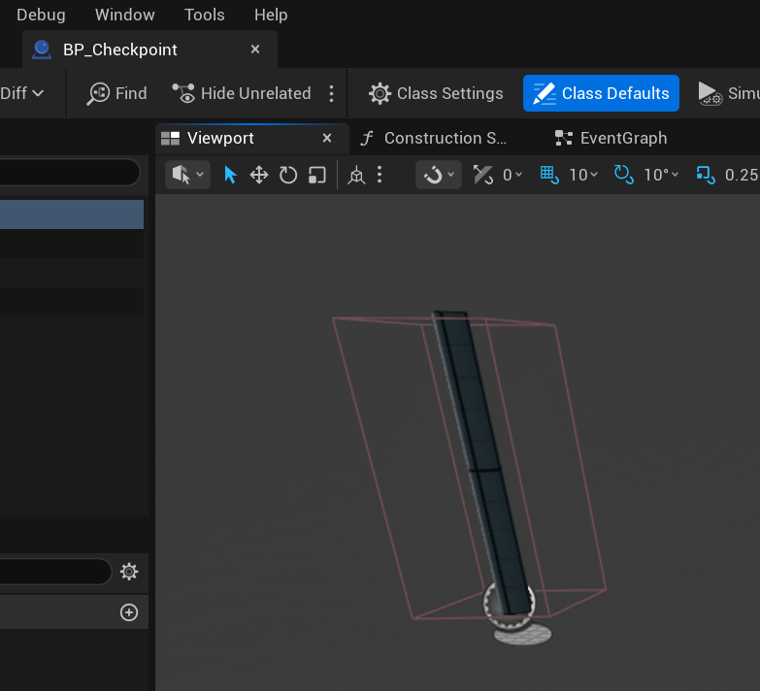
Checkpoints
The checkpoint is a post with a box collision deliberately larger than its mesh, so it is hard to miss.
BP_Checkpoint, viewport

Slide 32
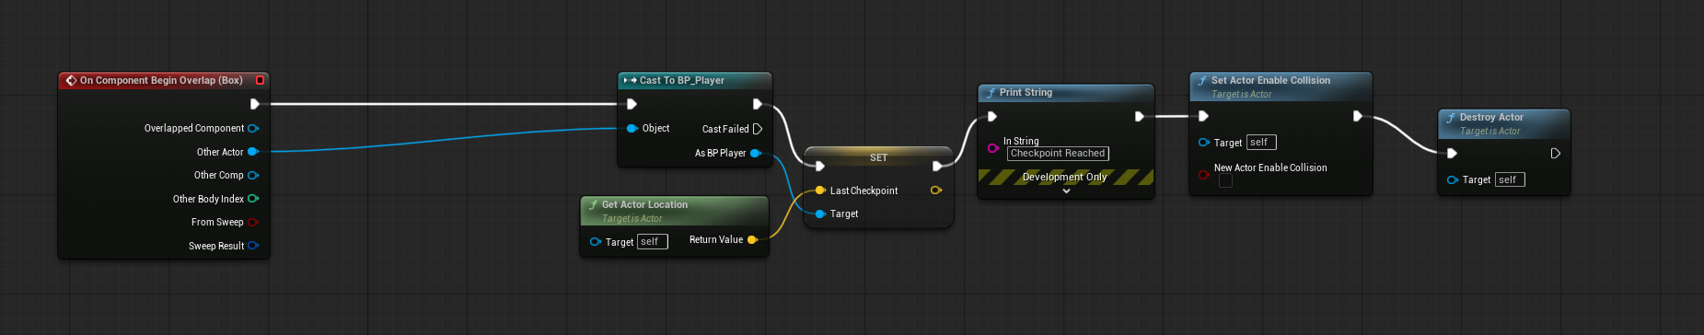
Saving your place
Touching it stores the location on the player and switches off its own collision so it only fires once.
BP_Checkpoint, Event Graph

Slide 33
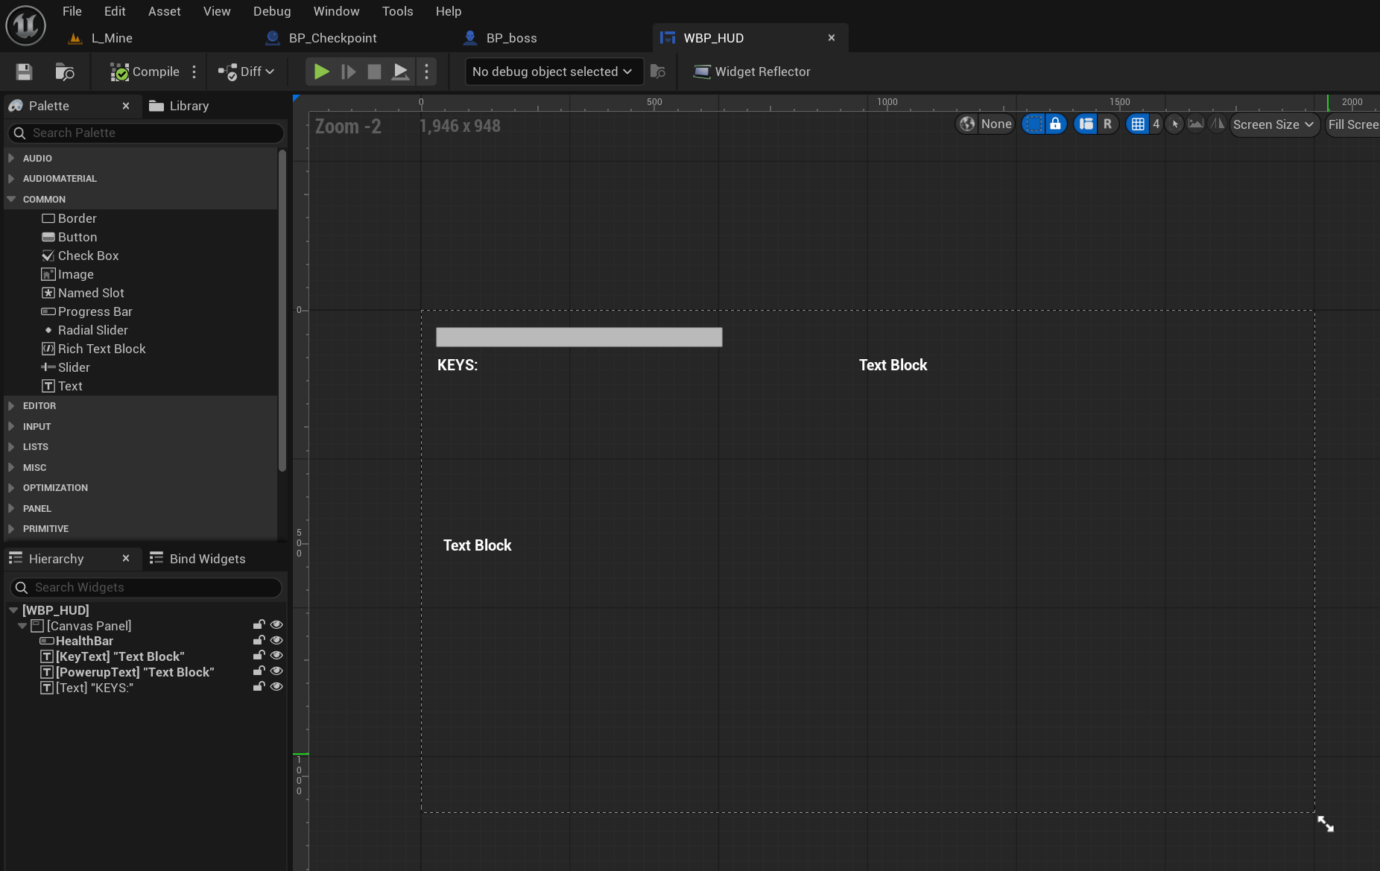
The HUD
The interface is deliberately minimal: a health bar, a key counter and a powerup label.
WBP_HUD, designer

Slide 34
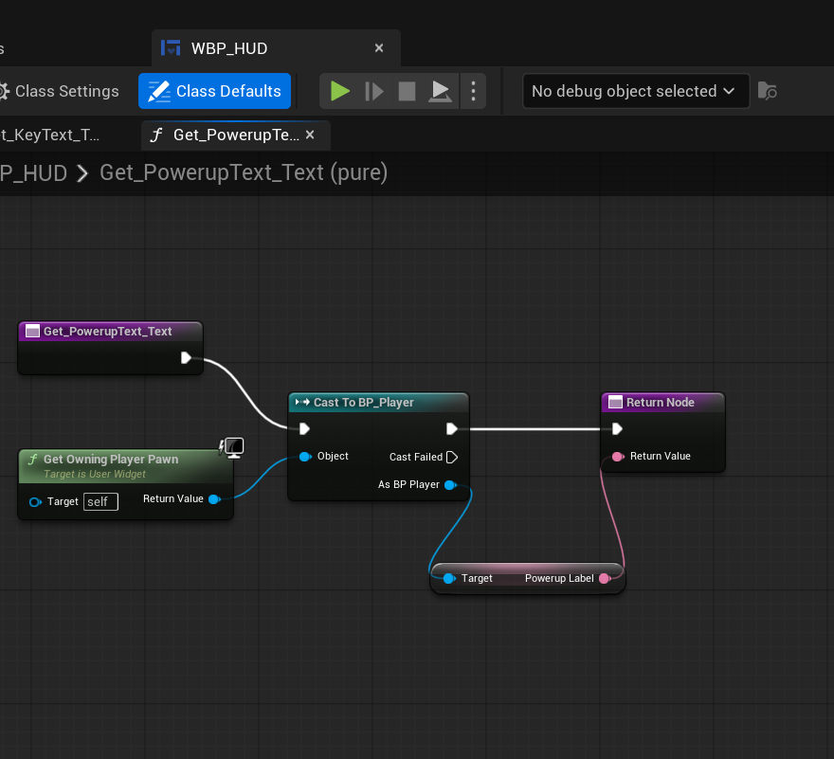
Reading the player
Each HUD element pulls its value from the player through a bound function that runs every frame.
WBP_HUD, text binding

Slide 35
What I learned
Scope first
Reuse beats repetition
The design document describes seven weapons and eight powerups. I built one weapon and two powerups, and recorded every cut and the reason for it.
Writing the health system once as a component meant the player, the bandits and the boss all shared it, and the boss took minutes rather than hours.
Unreal fails quietly
Debugging is a method
Most bugs produced no error at all. A pawn ignoring the visibility channel, a node defaulting its target to itself, a mesh whose collision was larger than the mesh.
Print strings to split a problem in half, collision view to see the invisible, and checking one thing at a time. That mattered more than knowing the engine.

